Slide 1
Step Count Analysis: Achieving 10,000 Steps Daily
A data-driven approach to improving daily physical activity.

Slide 2
Objective and Problem
Objective: Achieve a consistent daily step count of 10,000 steps.
Problem: Inconsistent step count, with current daily average at 6,703 steps.
Goal: Identify patterns, barriers, and solutions to meet the 10,000 step target.

Slide 3
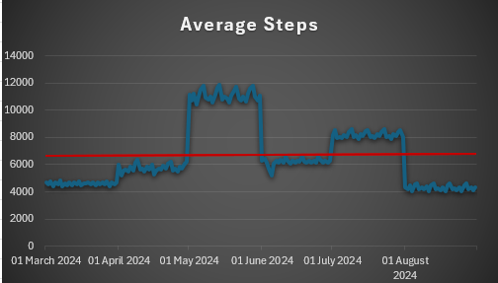
Data Summary
Average daily steps: 6,703 steps
Max steps: 11,900 steps (May)
Min steps: 4,005 steps (July & August)
Total steps recorded: 1,233,375

Slide 4
Trends and Insights
Activity increased in April and peaked in May, then dropped in June & August.
Inconsistent performance.
Influenced by external factors: Fatigue, work schedule and driving !

Slide 5
Challenges and Barriers
Time constraints: Fast-paced lifestyle, work, studies, and other commitments.
Fatigue: Particularly in the evenings.
Weather conditions: Impact on outdoor walking.

Slide 6
Action Plan for Improvement
Set smaller step goals (e.g., 2,500 steps in the morning, afternoon, evening).
Schedule walks during lunch and after work.
Use indoor alternatives (e.g., stairs, walking in place) during bad weather.

Slide 7
Expected Outcome
Incremental improvement in step count (8,000 by next month).
Achieve 10,000 steps consistently by the end of six months.
Overcome barriers like fatigue and weather through adjusted strategies.

